Slide 1

How to write a scientific article
Aurore Ponchon
https://github.com/auponchon/Writing_a_draft

Slide 2
What’s a scientific article?
Scientific production published in a peer-reviewed scientific journal
Way of communicating scientific advances
Specific format
Introduction
Material and methods
Results
Discussion
(Conclusion)

Slide 3
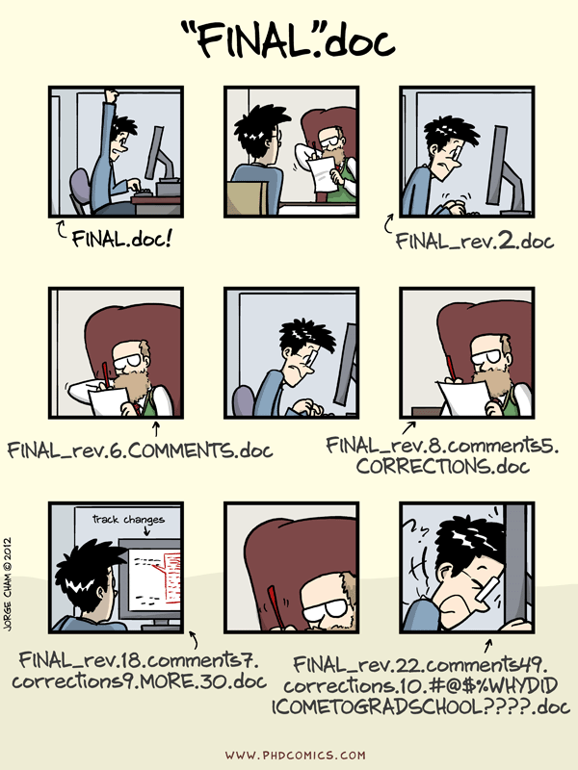
Document version
Brief explicit name
Assign a number or date
If date: 2025-03-16 not just 16/03 (could last several years!!)
Add your name initials
Writing a draft AP1.docx
2025-03-16-Writing a draft_AP.docx

Slide 4
Title
Short and concise
Use keywords directly in the title
Don’t be too specific if you target a journal with high impact factor

Slide 5
Authors and affiliations
If you write a manuscript from scratch and run most of analysis, you should be first author
Discuss authorship for other collaborators and their position in the list
Corresponding author is generally responsible for submission and contact with the editors

Slide 6
Abstract
Factual: Short context, objectives, how you did it, what you found, what you conclude (200-350 words)
What is the main message?
Two schools:
Write it FIRST. Good for people who like organising thoughts and stick to a predefined story
Write it LAST. Good for people who don’t like changing text too much and who prefer designing the story from results

Slide 7
Introduction
Aims at presenting the context of your work: why you do what you do?
Writing bullets with main idea of the paragraph generally helps stucture the introduction
Reading bibliography gives ideas/structure
In general, 3-4 double lined pages (2 min)
A good introduction responds to 4 main questions:
Why do we care?
What do we already know about the topic?
What is/are the current knowledge gap(s)?
How do we fill the knowledge gap(s) (=objectives)
What hypotheses are tested? (if you have some)

Slide 8
Methods
Aims at describing how you conducted your study: which data, how you collected them, with which protocols, which statistical analysis etc…
Should be the easiest and generally the first part written
Just describe step by step what you did in your analysis
Take examples in other studies using similar methods

Slide 9
Results
Prepare and order all your figures and tables first
Figures should be easily comprehensible
DESCRIBE results, do not INTERPRET
Write results before dicussion

Slide 10
Discussion
Summarise what the objectives of the study were (not mandatory)
Keep the same structure as that of Results
Explain ALL your results, including the non-significant ones or the ones going against your predictions
Relate your results to other studies or theory
What are implications?
Provide perspectives for future work
Acknowledge limits in your study if you think you have some
Don’t be scared of writing too much/off topic
Ideal length:3-7 double-spaced pages

Slide 11
Bibliography/references
References written by hand

Slide 12
Bibliography/references
References written by hand
References managed with a reference software (Zotero, EndNote, Mendeley, RefWork)

Slide 13
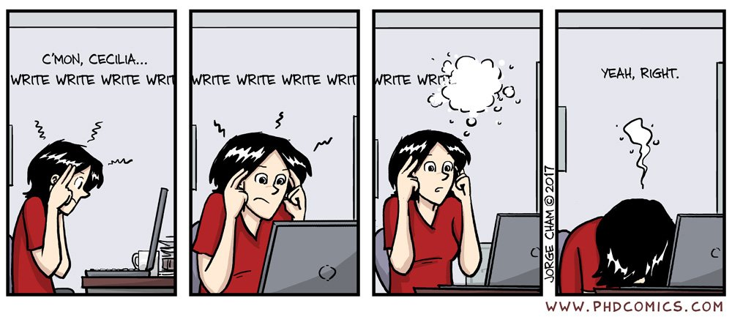
Overcoming the blank page syndrome

Slide 14
Overcoming the blank page syndrome
There is no proper way to write a paper. You can start wherever you want
You don’t have to write paragraphs in order
Allow yourself to be creative and bold
Don’t censor yourself, trust your ideas. Co-authors are there to adjust your text in case you go in the wrong direction
Most important is to have some words laid down. The more often you do it, the better you become

Slide 15
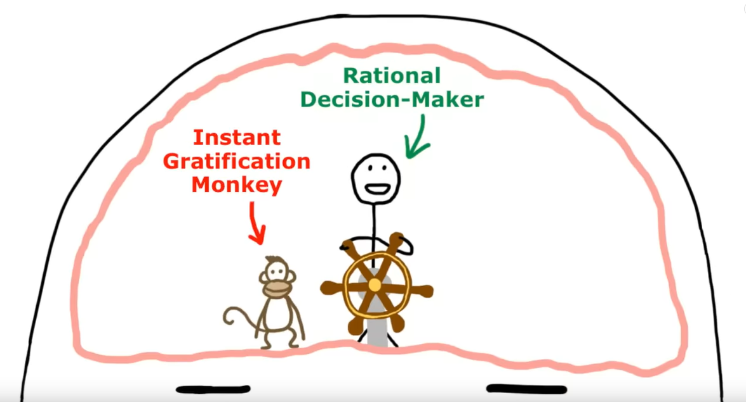
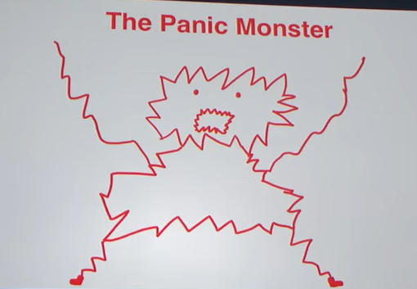
Overcoming procrastination
Inside the Mind of a Master Procrastinator | Tim Urban | TED talk
https://www.youtube.com/watch?v=arj7oStGLkU

Slide 16
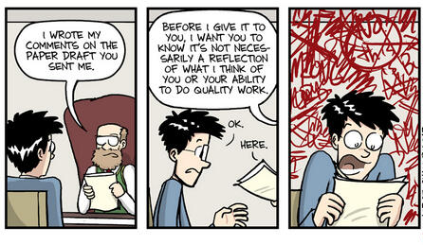
Preparing for submission
Check journal style (references and section titles)
Title, co-authors, affiliation, author for correspondance
Double spaced lines, line and page number
Check for word limit (abstract and main text)
Send your draft to co-authors with a deadline

Slide 17
Preparing for submission
Check journal style (references and section titles)
Title, co-authors, affiliation, author for correspondance
Double spaced lines, line and page number
Check for word limit (abstract and main text)
Send your draft to co-authors with a deadline
Don’t feel overwhelmed when receiving corrections. A lot of comments mean your co-authors took the job seriously and care for your work!
Choose potential reviewers/editors

Slide 18
Cover letter to the editor
Presents the manuscript
Don’t copy and paste the abstract
Explain why your work is important and how it is different from previous studies
Try to draw editor’s attention
Briefly explain the significance of your results
No more than a page!

Slide 19
Publication process
Submission via a portal specific to the journal
Manuscripts arrives in an editor’s hands
DESK REJECTION
Sent out for review
Assessed by anonymous referees
(beware of reviewer 2!!)
FINAL REJECTION
acceptance pending revision
rejection with possibility of resubmitting
Sent out for review
FINAL ACCEPTANCE

Slide 20
You have published a scientific article, congratulations!
https://github.com/auponchon/Writing_a_draft

